Slide 1

Omics data integration
Oren Tzfadia, Ph. D
Oren.Tzfadia@vib.be

Slide 2
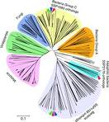
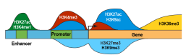
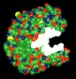
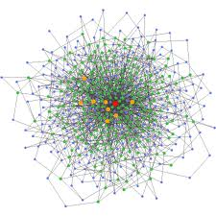

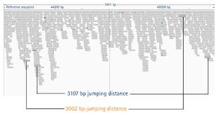
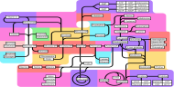
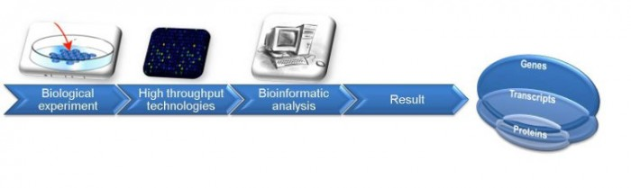
Functional genomics
Functional genomics: use the wealth of genomic data to learn functions, associations and interactions
Use available public databases

Slide 3
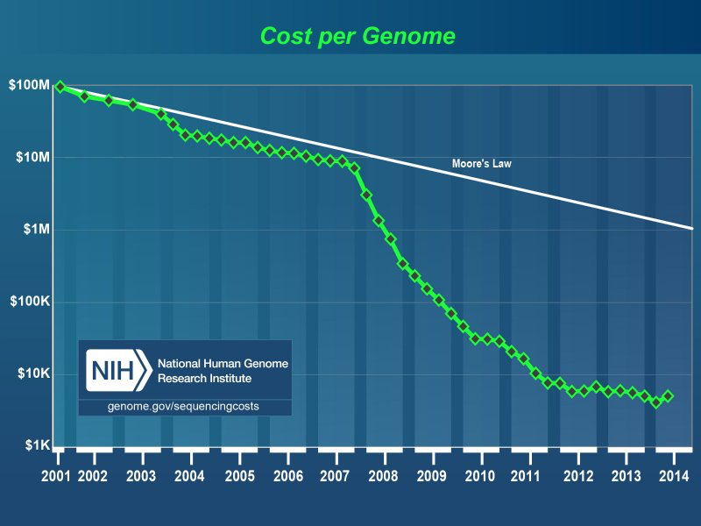

BIG DATA & Data Integration
Next Generation Sequencing (NGS, 2nd en 3rd generation) is THE revolution of the 21 century => changing biology!!!

Slide 4
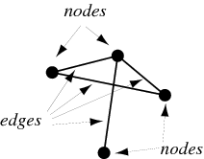
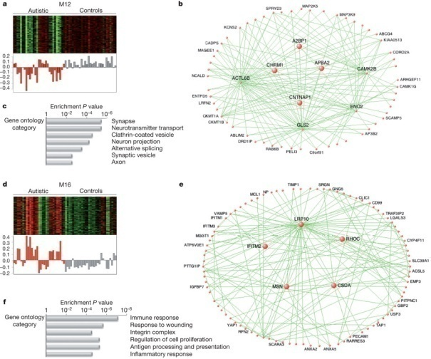
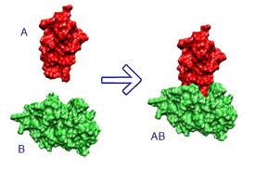
Biological networks
Nodes: genes/proteins or other molecules
Edges based on evidence for interaction
Protein-protein interactions
Gene co-expression
Metabolic networks
Voineagu et al. 2011 Nature

Slide 5
Omics Integration
(Gligorijević and Pržulj, 2015; Journal of the Royal Society Interface)

Slide 6
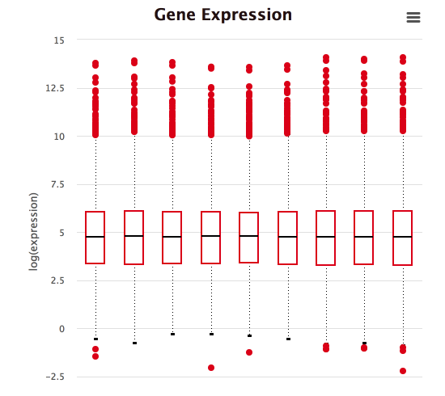
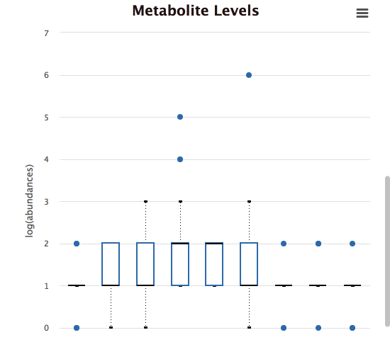
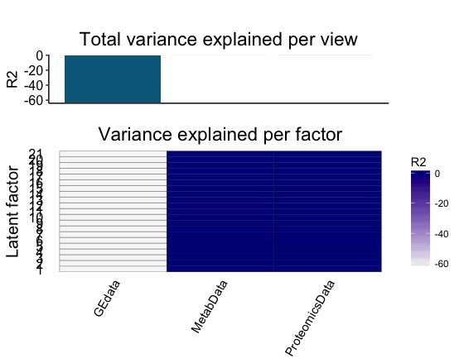
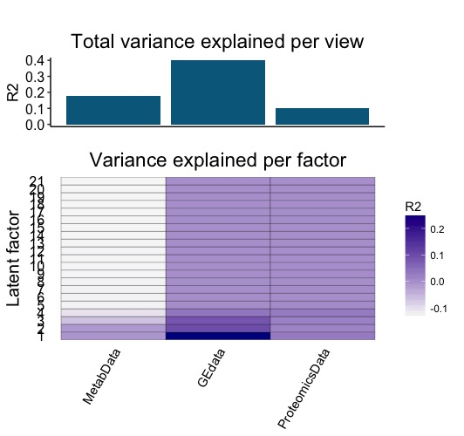
Preprocessing
BEFORE NORM
AFTER NORM

Slide 7
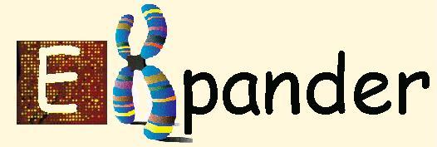
EXPression ANalyzer and DisplayER
EXPANDER – an integrative package for analysis of gene expression data
Adi Maron-Katz
Igor Ulitsky
Chaim Linhart
Amos Tanay
Rani Elkon
Oren Tzfadia
Tom Hait
Dorit Sagir
Eyal David
Roded Sharan
David Amar
Yossi Shiloh
Ron Shamir
Ron Shamir’s Computational Genomics Group Tel Aviv University

Slide 8
What can it do?
Low level analysis
Data adjustments (missing values, merging, divide by base, log)
Normalization
Probes & condition filtering
High level analysis
Group detection (supervised clustering, differential expression, clustering, bi-clustering, network based grouping).
Ascribing biological meaning to patterns via enrichment analysis

Slide 9
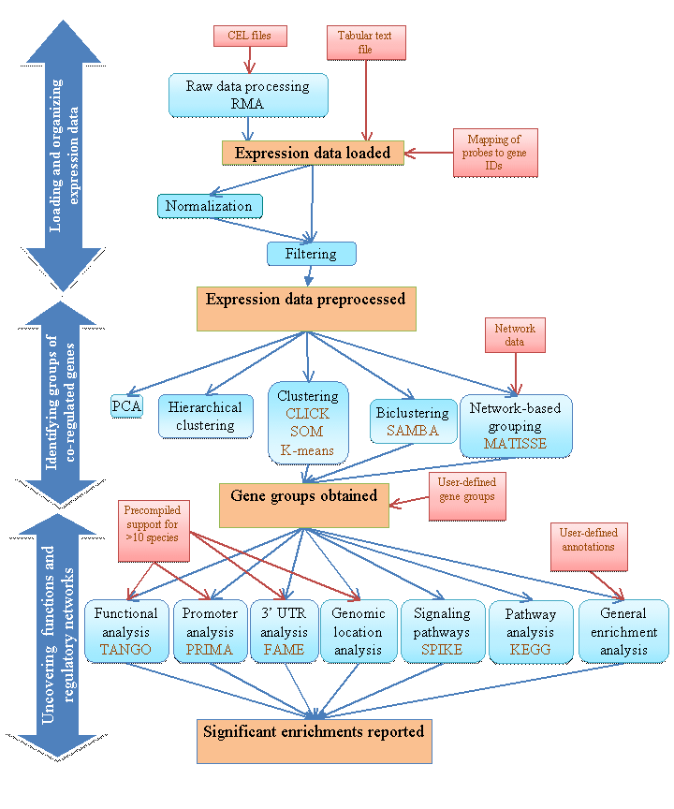

Slide 10
First steps with the data – load, define, preprocess
Load dialog box , “Data menu”, “Preprocessing menu”
Data definitions
Defining condition subsets
Data type & scale (log)
Define genes of interest
Data Adjustments
Missing value estimation (KNN or arbitrary)
Flooring
Condition reordering
Merging conditions
Merging probes by gene IDs
Divide by base
Log data (base 2)

Slide 11
Data preprocessing
Normalization= removal of systematic biases
Quantile = equalizes distributions
Lowess (locally weighted scatter plot smoothing) = a non linear regression to a base array
Visualizations to inspect normalization:
box plots
Scatter plots (simple and M vs. A)
M=log₂(A1/A2)
A = 0.5*log₂(A1*A2)

Slide 12
Unsupervised grouping - cluster Analysis
Partition into distinct groups, each with a particular expression pattern
co-expression → co-function
co-expression → co-regulation
Partition the genes attempts to maximize:
Homogeneity within clusters
Separation between clusters

Slide 13
Cluster Analysis within Expander
Implemented algorithms:
CLICK, K-means, SOM, Hierarchical
Visualization:
Mean expression patterns
Heat-maps
Chromosomal positions
Network sub-graph (Cytoscape integration)
PCA
Clustered heat map

Slide 14
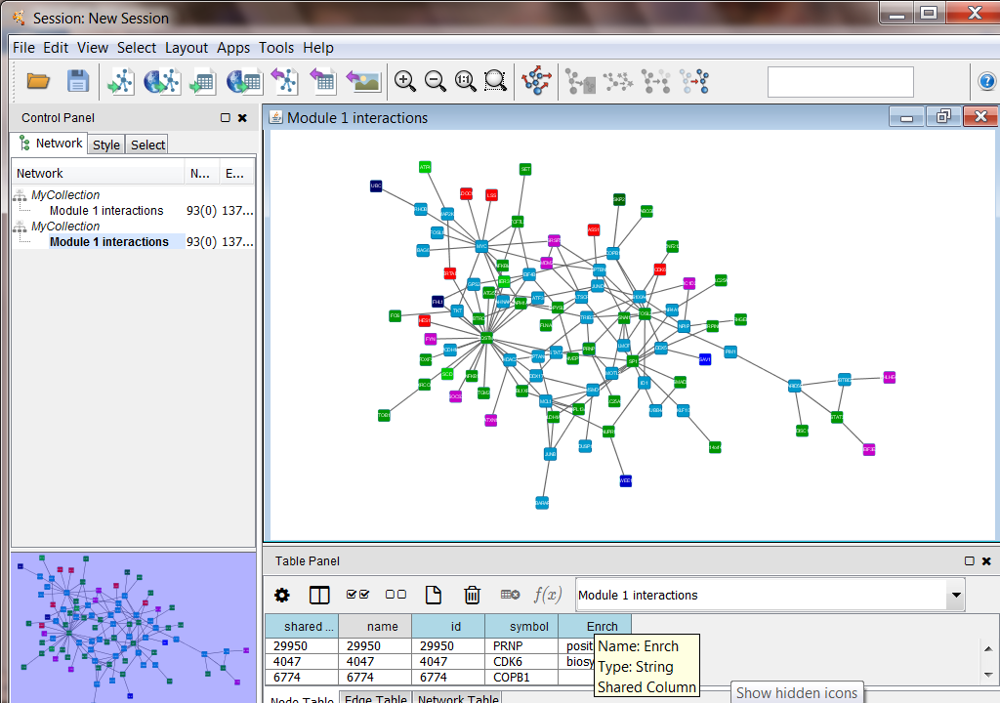
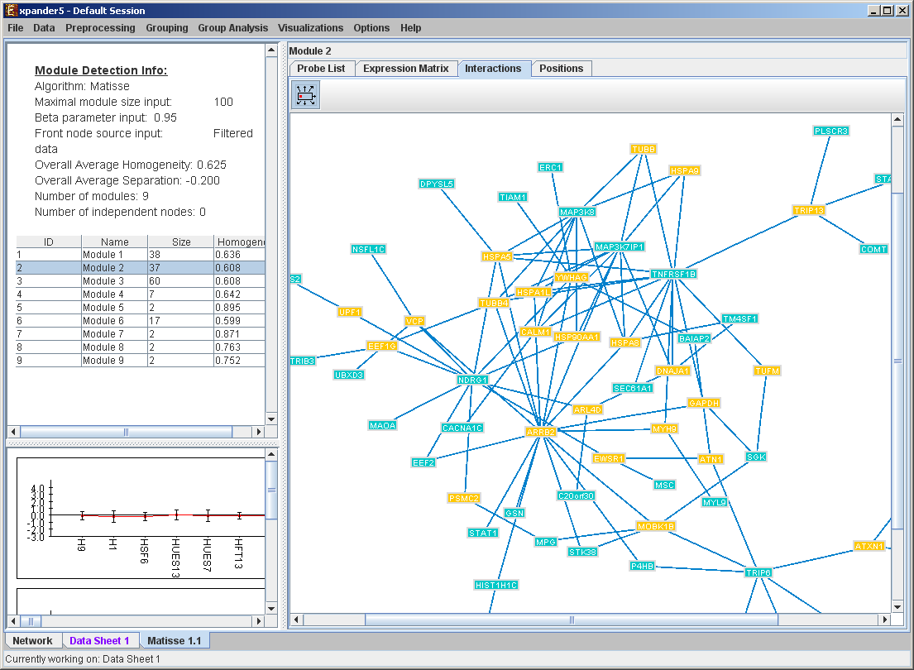
Network based clustering visualization
Similar to clustering visualization (gene list, mean patterns, heat maps, etc.).
Interactions map – Cytoscape interface

Slide 15
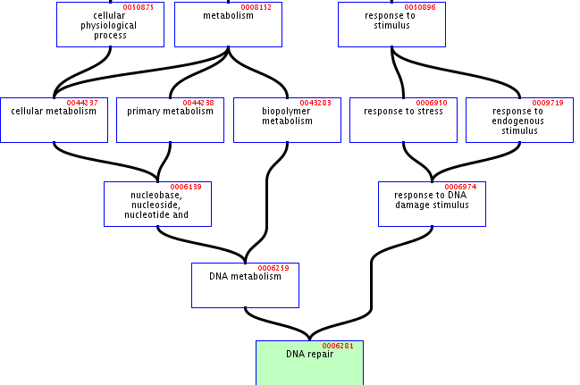
Enriched GO Functional Categories
Hierarchical structure → highly dependent categories.
Problems:
High redundancy
Multiple testing corrections assume independent tests
TANGO

Slide 16
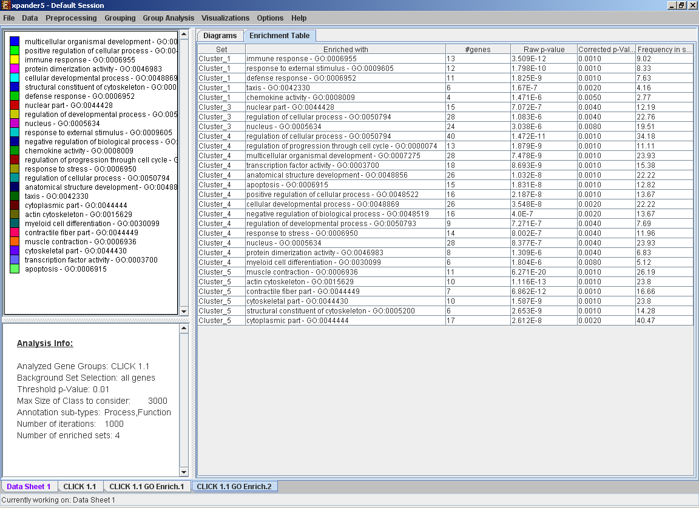
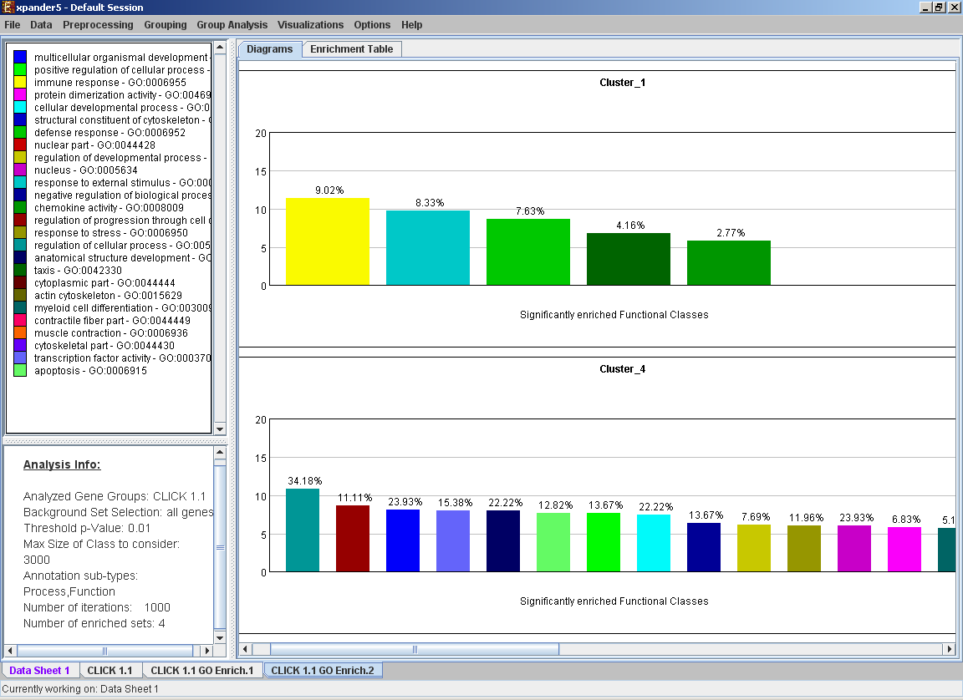
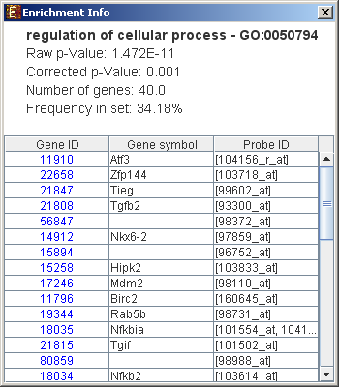
Functional Enrichment - Visualization
Can be saves as a tabular .txt file

Slide 17
Inferring regulatory mechanisms from gene expression data
Assumption:
co-expression → transcriptional co-regulation → common cis-regulatory promoter elements
Computational identification of cis-regulatory elements over-represention
PRIMA - PRomoter Integration in Microarray Analysis (Elkon, et. Al, Genome Research , 2003)
AMADEUS – novel motif enrichment analysis

Slide 18
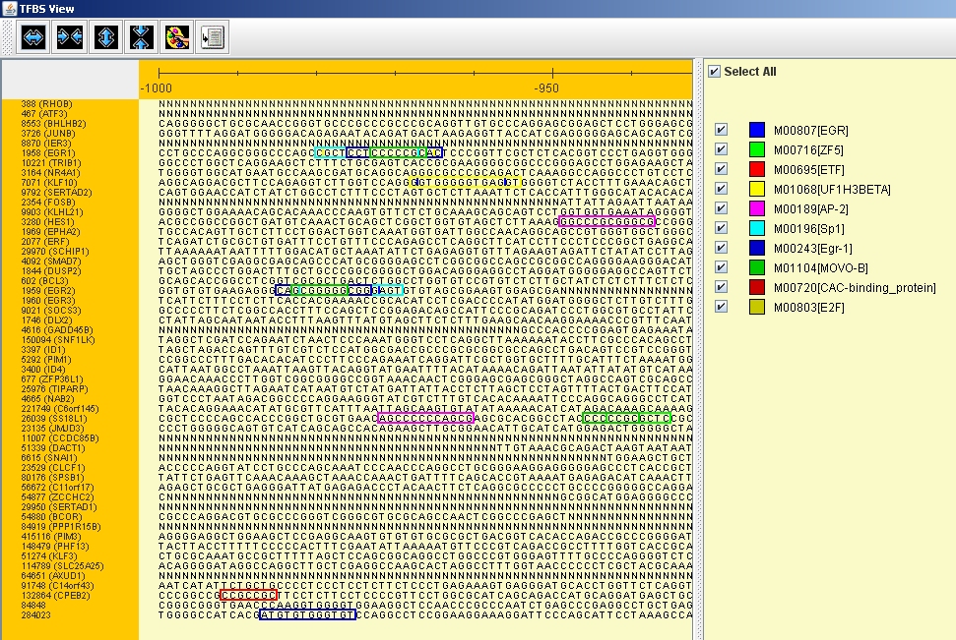
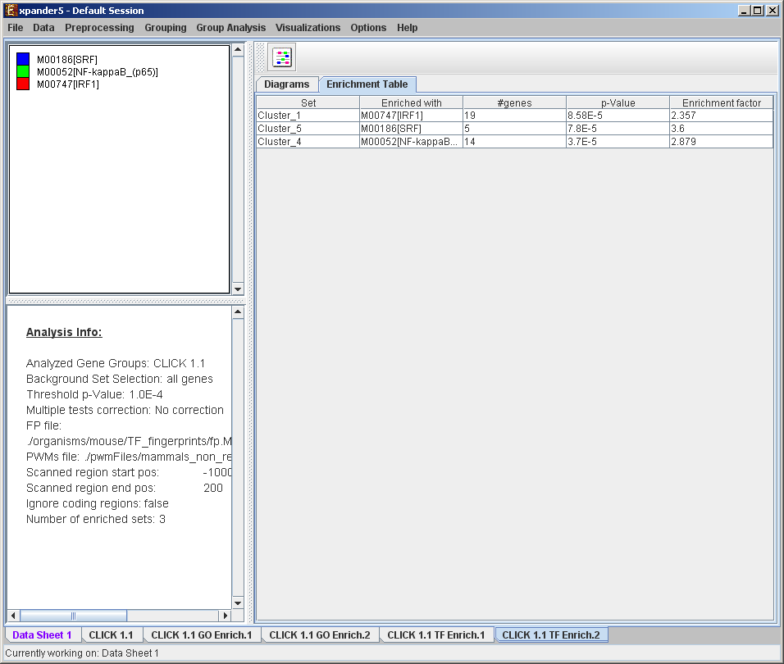
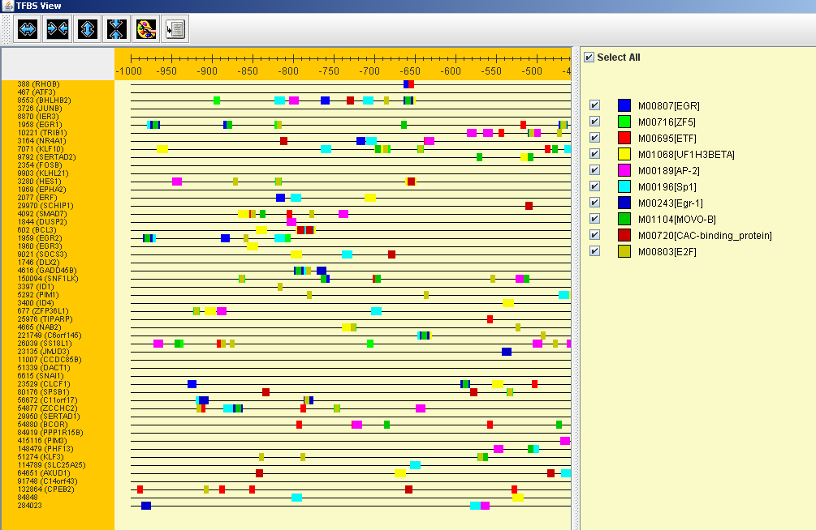
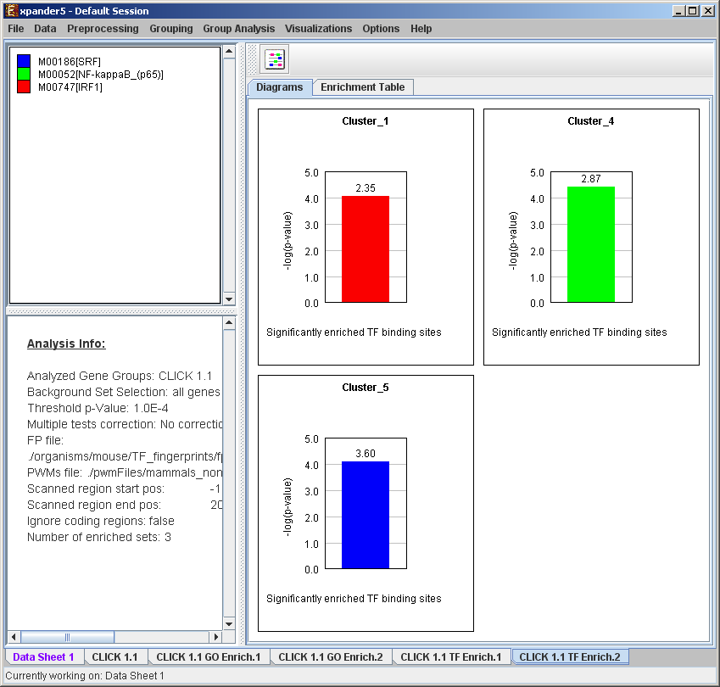
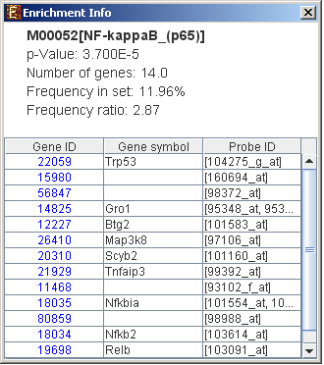
Promoter Analysis - Visualization
Frequency ratio

Slide 19
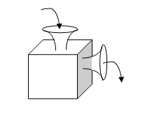
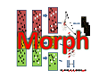
MORPH (MOdule-guided Ranking of candidate PatHway genes)
Input:
A pathway gene set
Gene expression (M matrices)*
Gene clustering solutions (N solutions)**
Output:
Pathway signature strength + ranking of candidate genes
* Integration of unlimited # of data sources
** Can use any (gen)omic data that can be clustered
Pathway gene set
Expression datasets
Clustering solutions
Rank candidate genes
Tzfadia et al., 2012; Plant Cell

Slide 20
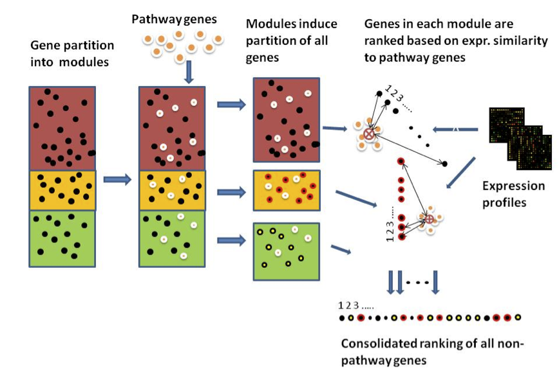
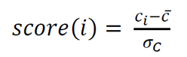
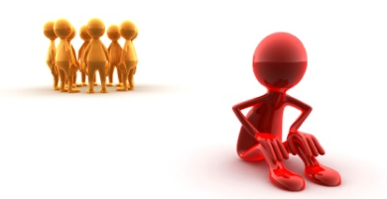
Module guided ranking
Score normalization
Tzfadia et al., 2012; Plant Cell

Slide 21
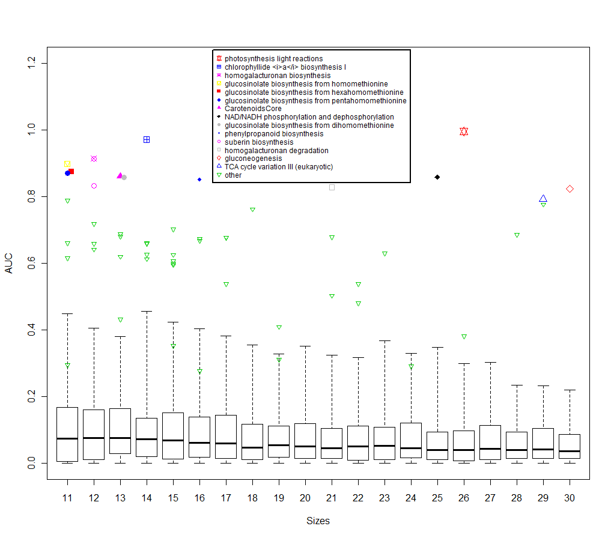
Real Pathways Vs Random Selected Gene Sets

Slide 22
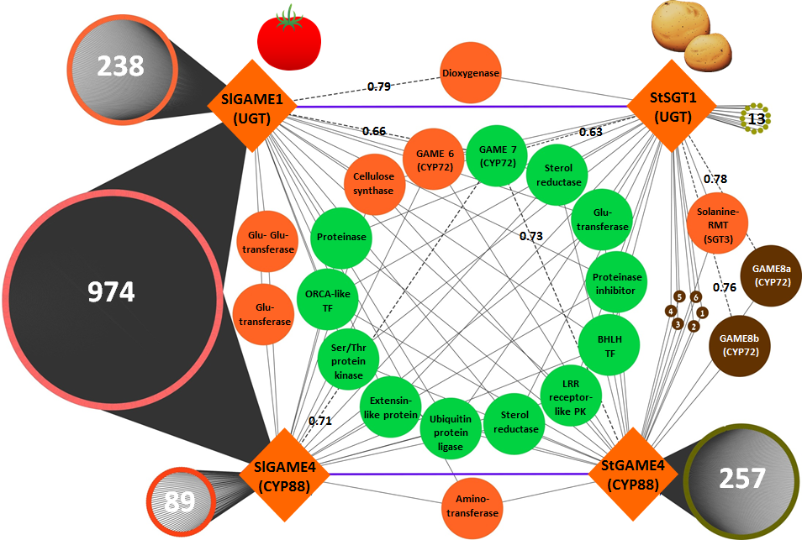
Comparative Genomics Co-expression Framework

Slide 23
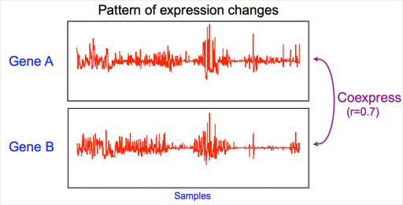
Co-expression
Co-expression: measure correlation between genes
conditions
Expression levels:
mRNA
abundance
genes
We assume that co-regulated genes are co-expressed
Co-expression depends on the conditions
Co-expressed genes in leafs are not necessarily co-expressed in seeds

Slide 24
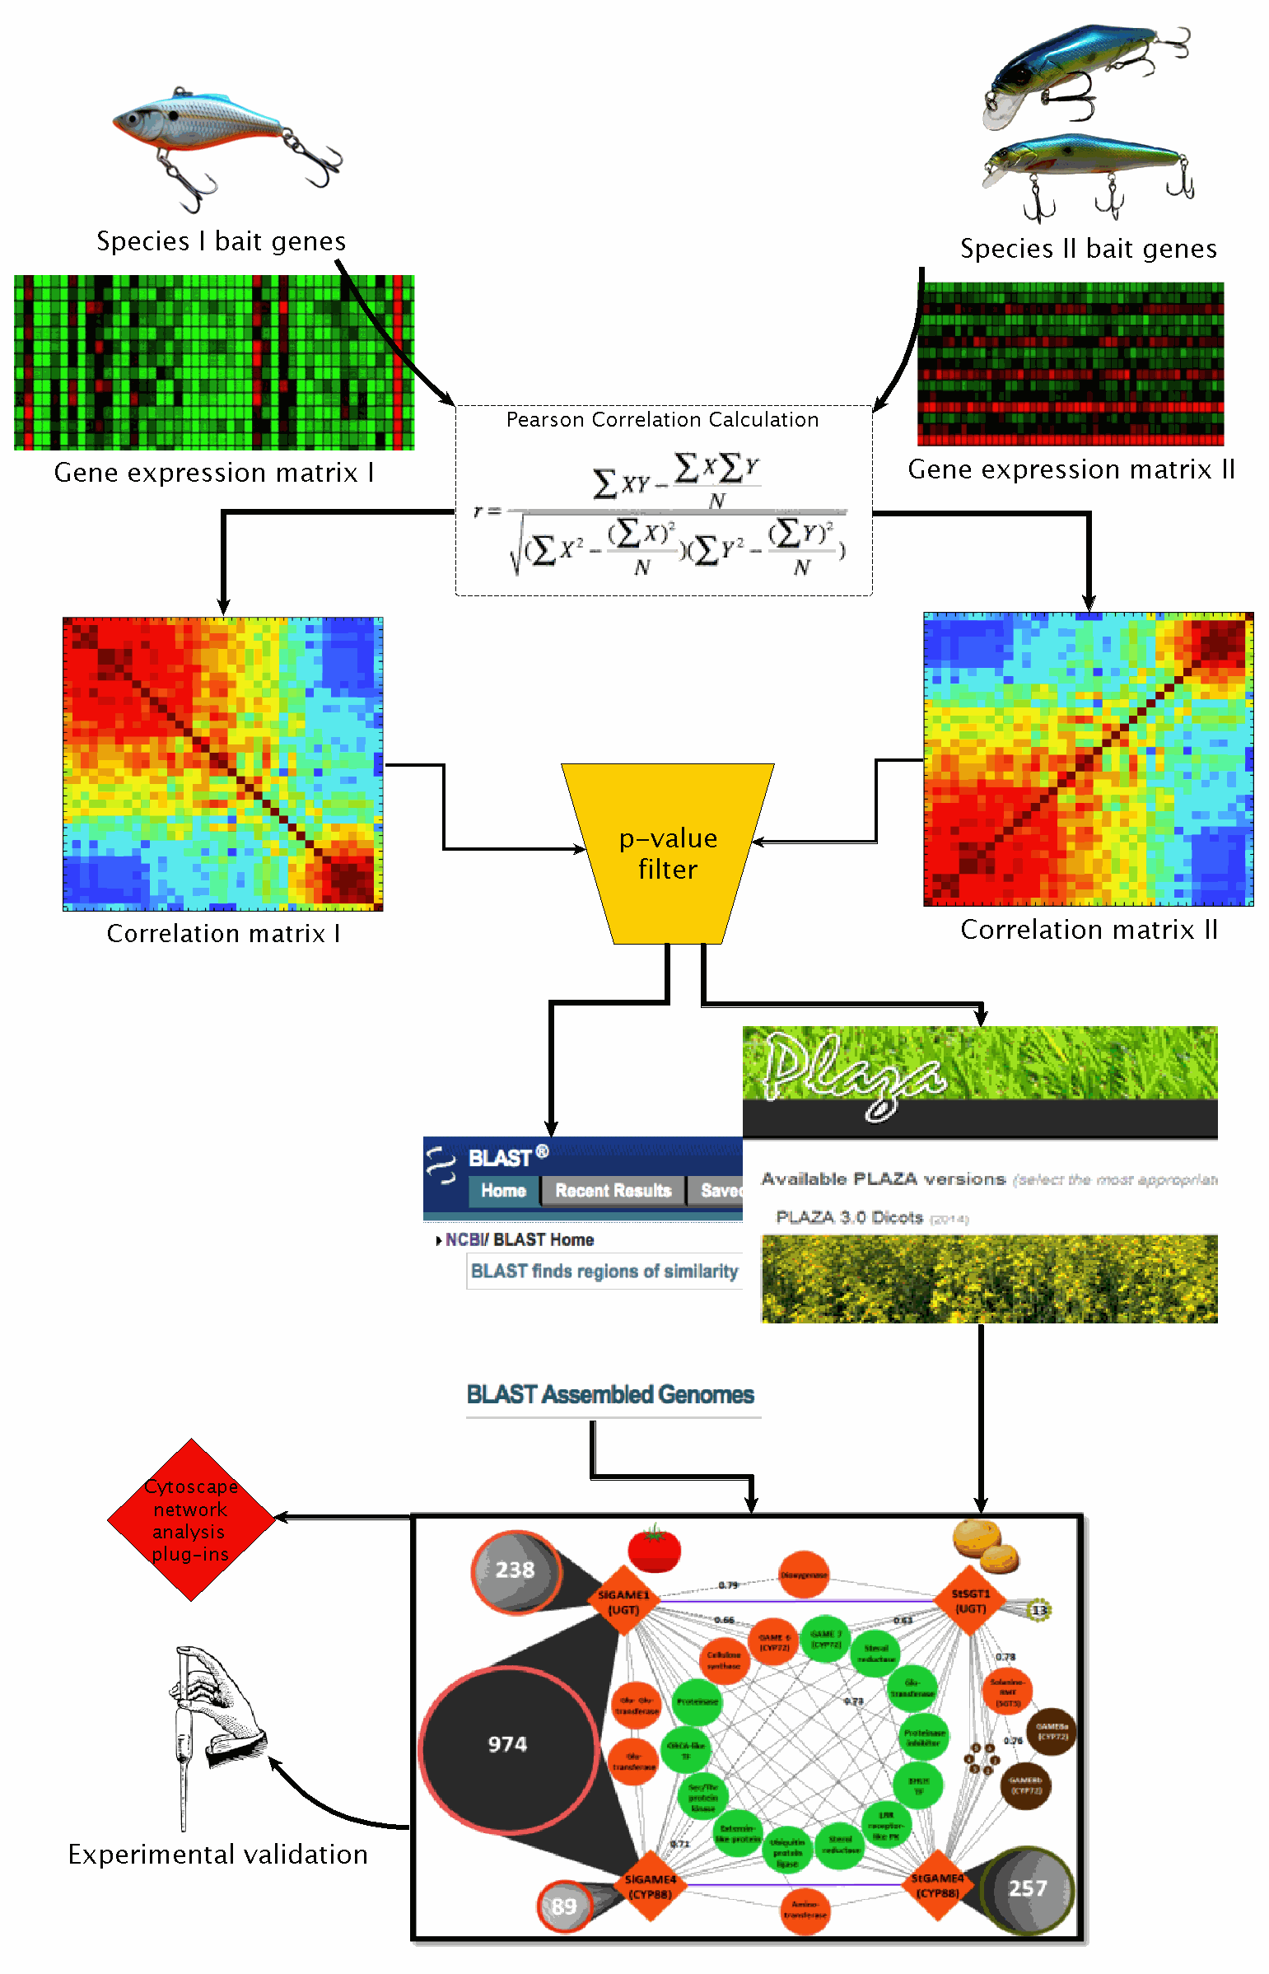
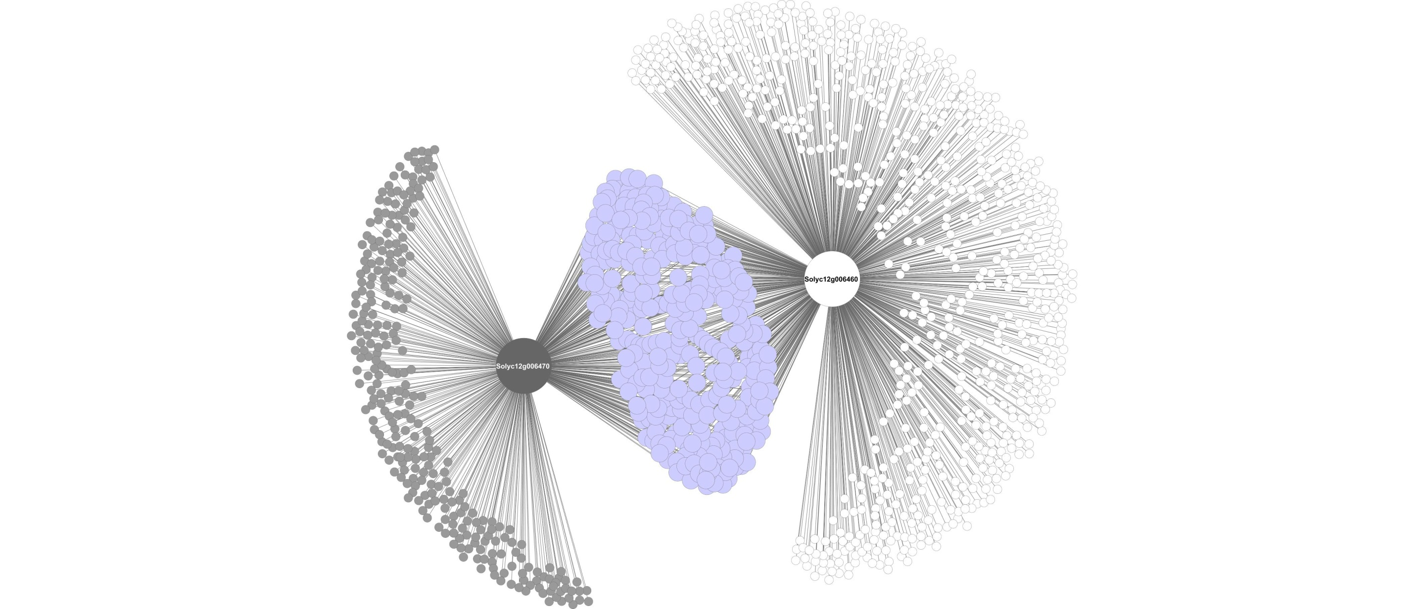
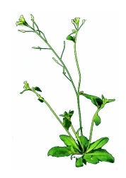
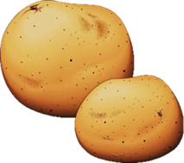


Slide 25
Comparative Genomics Co-expression Network
Itkin et al., 2013; Science

Slide 26
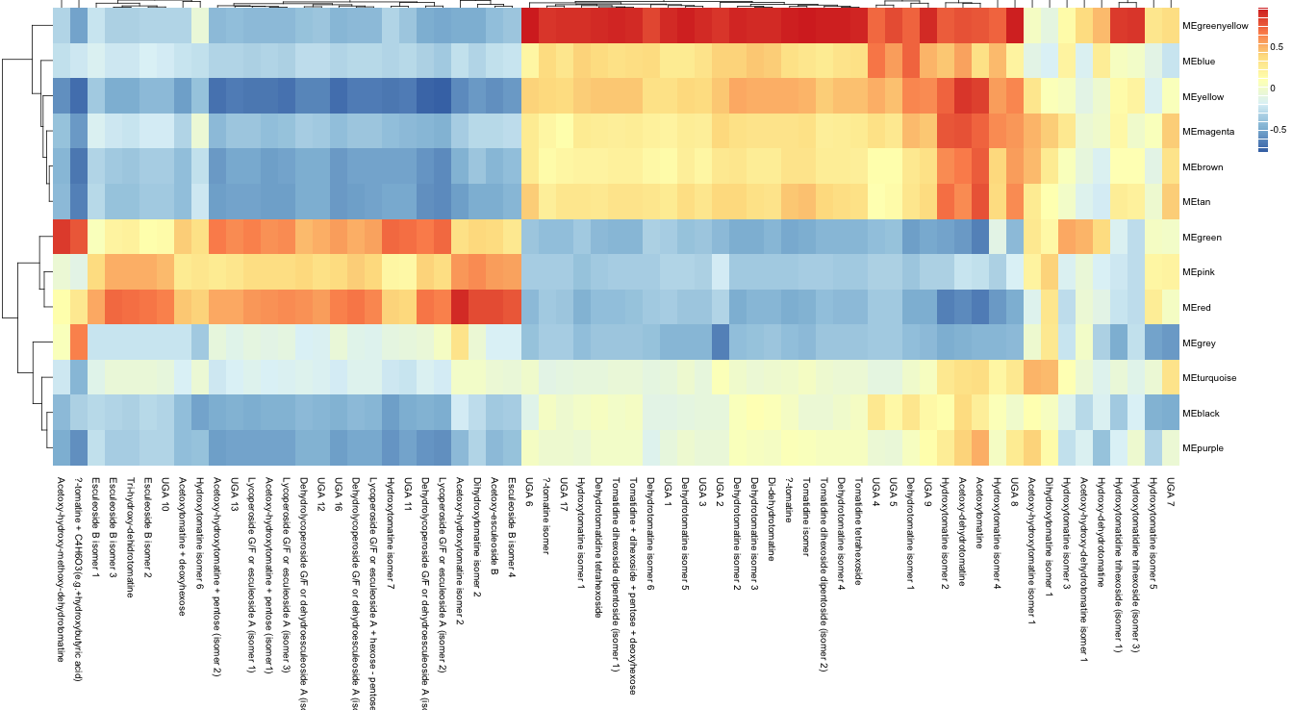
WGCNA
Gene Clusters
metabolites
Notes:
Here, we correlate clusters of transcription factors with glycoalkaloids levels in 10 tissues of tomato
Now, we make this picture a little easier to read by transforming it to a network!

Slide 27
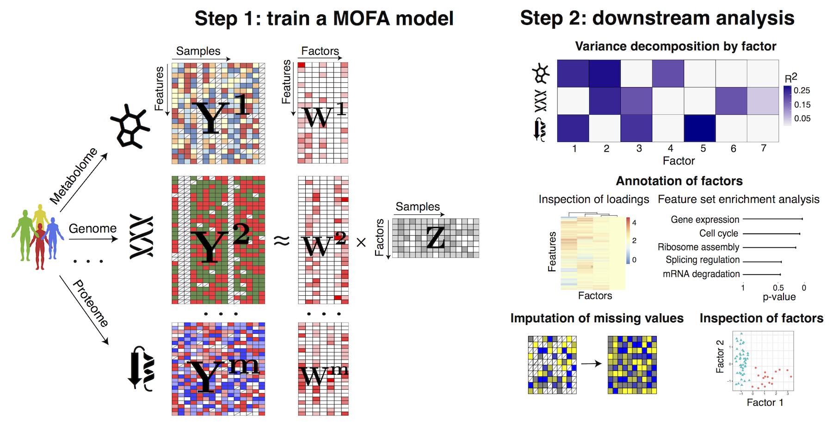
MOFA

Slide 28
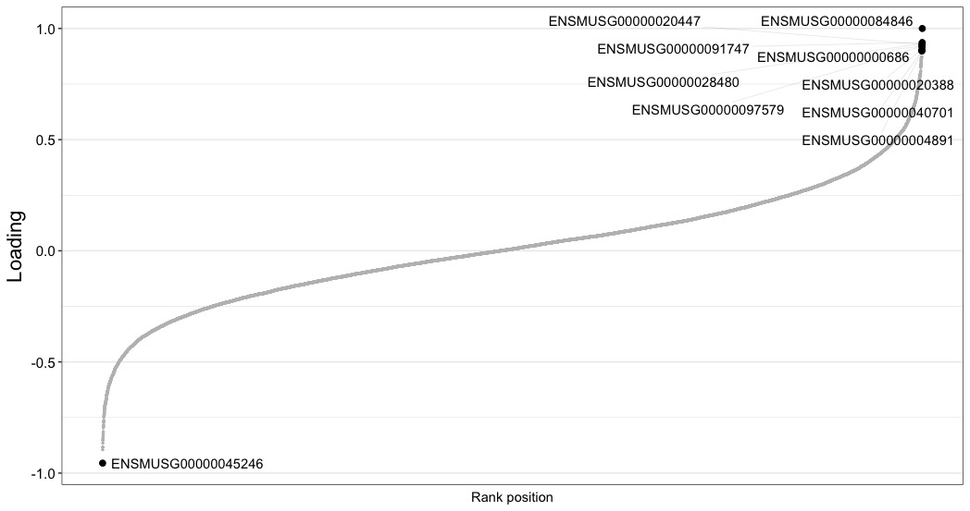
MOFA
TOP DRIVERS FACTOR 1 TRANSCRIPTOME

Slide 29
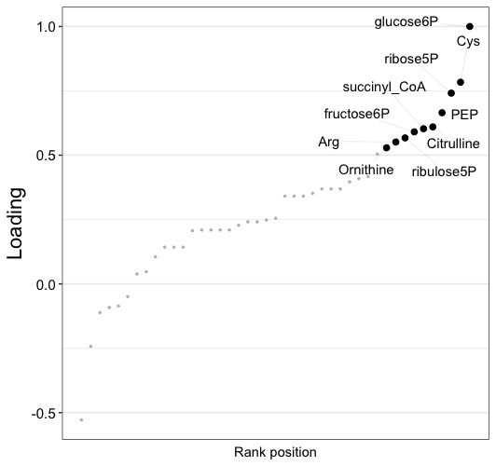
MOFA
TOP DRIVERS FACTOR 1 METABOLOME

Slide 30
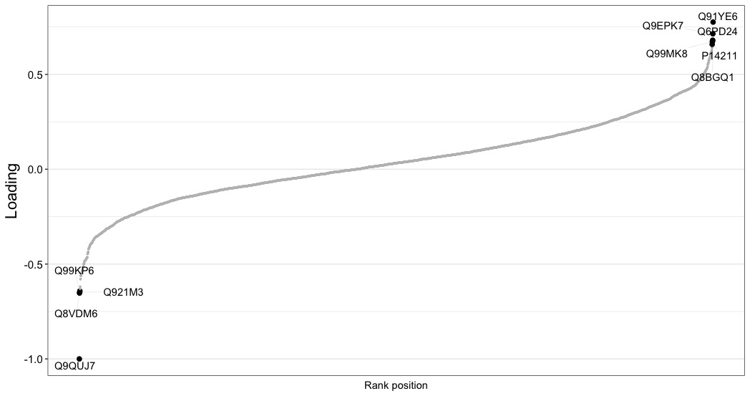
MOFA
TOP DRIVERS FACTOR 1 PROTEOME

Slide 31
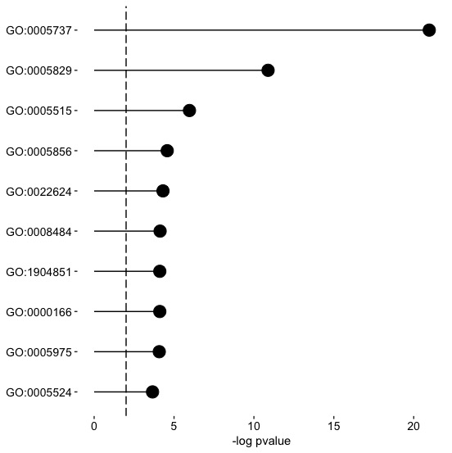
MOFA
TOP GO terms

Slide 32
Mixomics
sPLS (sparse Partial Least Squares)

Slide 33
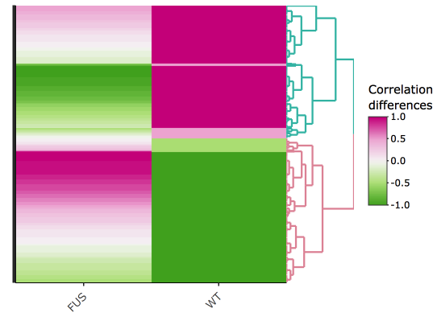
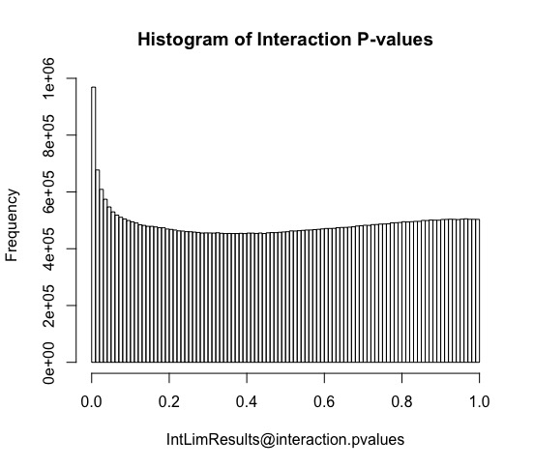
INTLIM

Slide 34
Thank you!

